Slide 1




ADTA 5340.003 Discovery and Learning with Big Data
SNAP-Up
Elevating Families Out of Poverty
Through Innovative Policy
Group 4:
Kamini Suresh Yelamar
Narayan Dharmendra Raval
Srikanth Manchimchetty
Sudeshna Vellamkonda

Slide 2


Overview
Introduction
Problem Statement
Business Understanding
What is SNAP?
How can ML help?
Data Understanding & Data Plan
Machine Learning Models
Strategy
Conclusion & Recommendation
Our Team

Slide 3


Introduction
The American Community Survey (ACS) stands as an important program conducted by the United States Census Bureau, delivering valuable insights about the nation's population and housing characteristics. Our team, comprising four dedicated members, has undertaken the task of integrating the wealth of data provided by the ACS to address critical questions surrounding the distribution of SNAP benefits and socioeconomic disparities across different geographic areas. Food and Nutrition Service (FNS) under the United States Department of Agriculture works with several industries to run Supplemental Nutrition Assistance Program (SNAP).

Slide 4



ADTA 5340.003 Discovery and Learning with Big Data
Problem Statement
Food and Nutrition Service under Department of Agriculture (USDA) handles the SNAP eligibility and distribution among low-income households.
We are aiming to propose different policies which could be implemented to enhance employment opportunities and build financial stability within these families.
These policies will be intending to lift/bring these families above poverty line while utilizing optimized snap benefits and will be determined using machine learning algorithms..

Slide 5






Current Scenario
FNS analyzes and distributes the SNAP benefits to the low-income households. Each year the benefits are reviewed and optimized.
Business Understanding
Strategy
Utilizing Machine Learning Model to understand which regions are lacking in various factors such as Education, employment etc.
Challenges Faced
Some of the native lands have many low-income households compared to other, affecting economic state of the region.
Objectives
To suggest policies which would empower these families and lead to better future, while utilizing SNAP’s optimized benefits.
Call to action
The funds should get properly distributed for suggested policies, since its one-time-investment to empower the nation and build brighter future.
Innovation
Proposing the idea to federal government which would help them organize funds efficiently.

Slide 6





What is SNAP eligibility?
Income Limit
Family Composition
Asset Limit
Work Requirements
For a household of one: $1,055 per month or $12,660 per year
For each additional person, add: $369 per month or $4,428 per year
Number of individuals living in the household and their relationship to one another
For each household $2,250 or less in countable resources
And with elderly or disabled person , the asset limit is $3,500 or less.
Able-bodied adults without dependents (ABAWDs) aged 18 to 49 may be subject to work requirements.
This Photo by Unknown Author is licensed under CC BY-SA
This Photo by Unknown Author is licensed under CC BY-NC
This Photo by Unknown Author is licensed under CC BY-SA

Slide 7







How can Machine Learning help here?
Machine learning model can learn and analyze different patterns of data collected from American Community Survey (ACS).
01
02
03
04
Determine the regions with high below poverty families
Clustering states with similar economic condition
Analyze the data
Extract important features

Slide 8
Data Understanding
Machine learning model can learn and analyze different patterns of data collected from American Community Survey (ACS).
Data Source: American Community Survey (ACS)
Dimension: 562 * 59
Features: Types Of Earnings, House-Hold Makeup , Income, Gender, Education , Poverty, Employment, Race, Age

Slide 9











Data Plan
Exploratory data Analysis
Results
Setting Objective
Data Collection from ACS
Data Processing and Preparation
Implementation of Machine Learning Model
Recommendation

Slide 10
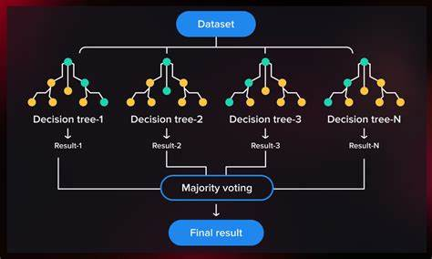
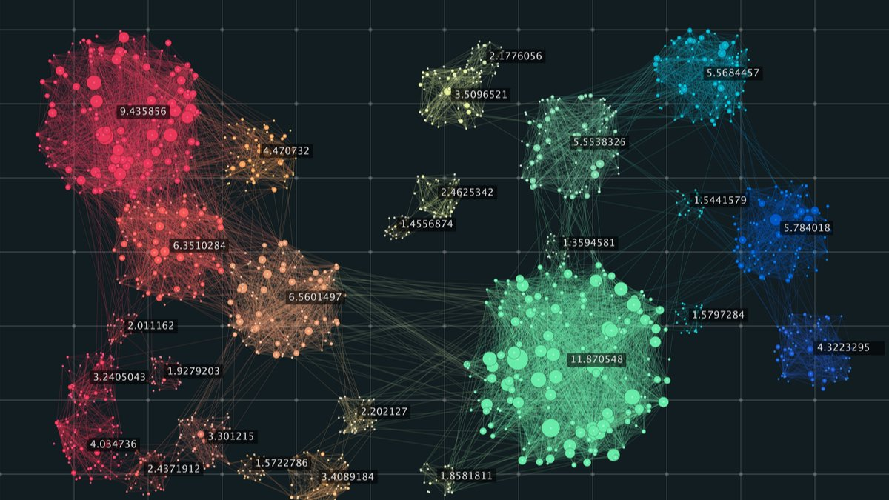

Machine Learning Model
Random Forest Regressor
Clustering
ADTA 5340.003 Discovery and Learning with Big Data

Slide 11

Statistics

Slide 12
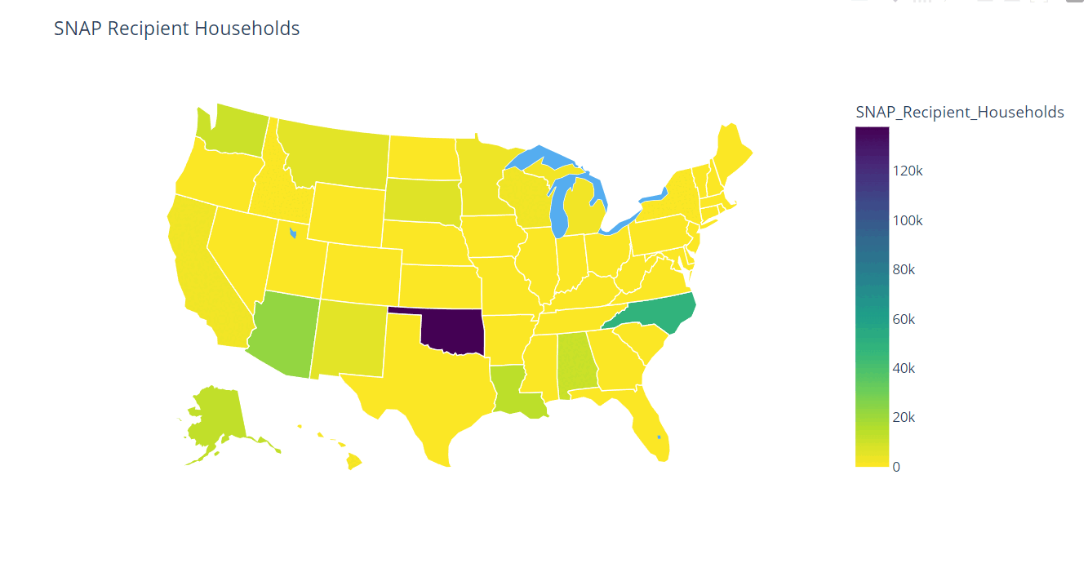

Slide 13


Important Features
0.052
People above 65 years
0.041
25+ years with bachelors and associate degree
18-24 age group with less than high-school education
0.063
0.022
18-34 years below poverty
0.031
Over 25 years with less than 9th grade
0.028
Unemployed
Civilian labor

Slide 14
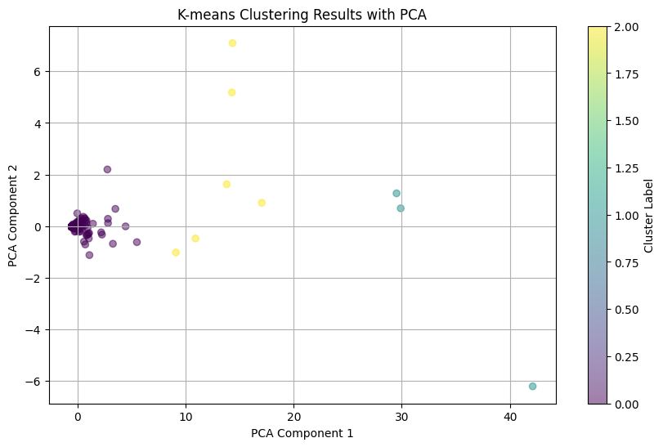
Clusters of native lands where the strategies should be implied
Cluster 1: 'New Mexico’ ,'California’ ,'Texas’ ,'New York’ ,'Alaska’, 'Maine' 'Wisconsin’ ,'Nevada’ ,'Michigan’ ,'Florida’, 'Montana’ ,'Minnesota’ ,'Oregon’ ,'South Carolina’, 'Washington’ ,'South Dakota’ , 'Idaho’, 'North Dakota’, 'Kansas’ ,'Mississippi’, 'Connecticut’ ,'Nebraska’, 'Utah’, 'Alabama’ ,'Iowa’ ,'Colorado' 'Massachusetts’ ,'Wyoming’ ,'Hawaii’, 'Virginia’ ,'Delaware’ ,'New Jersey’
Cluster 2: 'Oklahoma’, 'North Carolina’
Cluster 3: 'Arizona’, 'Oklahoma’, 'Louisiana'

Slide 15


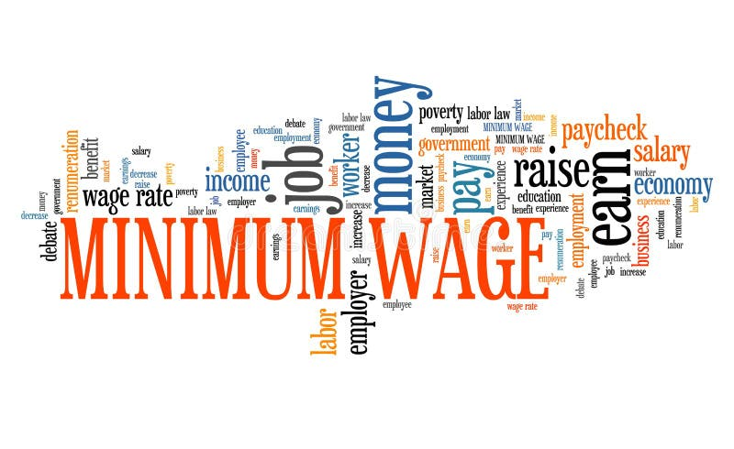

Strategy
Fair Wage Adjustment Policy
Learning Enrichment Initiative
Entrepreneurial Edge

Slide 16

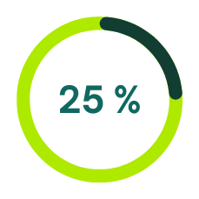


Conclusion & Recommendation
To conclude, government should focus on :
Learning Enrichment Initiative
Spread awareness and optimize education policies, which will be affordable to everyone.
Entrepreneurial Edge
The department should encourage new startups and small business ideas, which will create new employment.
Fair Wage Adjustment Policy
Daily wages should be revised to make families financially stable to lower below-poverty level family count.

Slide 17




Our Team
Group 4
Kamini Yelamar
Narayan Raval
Sai Sudeshna
Sai Srikanth
Data Storyteller
ML Expert
Data Analyst
Data Researcher
This Photo by Unknown Author is licensed under CC BY-NC

Slide 18

Let’s
SNAP-Up
Together, Towards Zero Poverty
ADTA 5340.003 Discovery and Learning with Big Data

Slide 19

THANK YOU
For watching this presentation
Group 4

